Slide 1

Mapping SDGs by Faculty to find new interdisciplinary collaborations, a type of Linked Literature Analysis
Jeffrey Demaine

Slide 2
Outline
Part 1: Mapping SDGs by Faculty
SDG publications by faculty :: interdisciplinarity
Identification of potential collaborations
Expert input in selecting collaborators
Part 2: Parallels with Linked Literature Analysis
Can LLA be automated?
Application to Bibliometrics & Scholarly Communication
LLA in LLMs
Take-home message:
3 techniques you can use to analyze/identify collaborations.
Predictive analytics as new conceptual approach to Bibliometrics.
Notes:
Identification of potential collaborations
The ANZSRC is a hierarchy of 1,754 specific research Fields organized into 190 broader Groups that are in turn collected into 23 general research Divisions. Dimensions assigns two levels of ANZSRC codes to publications: two-digit Divisions (e.g. “34 Chemical Sciences”), four-digit Groups (e.g. “3402 Inorganic Chemistry”). Potential co-authors are identified by selecting publications with matching SDG and ANZSRC Field of Research classifications, but where the authors’ faculty affiliations are different.
Expert input in selecting collaborators
The manipulation of structured information should be used to inform, but not replace, expert input. The final step of this process is to provide the managers and administrators who understand the needs of the institution with a range of choices in an accessible format. By combining the ability to process large quantities of data with the contextual knowledge of humans can insights be drawn.

Slide 3
Mapping SDGs by Faculty – 3 steps
Demaine, J., Bhatia, Y., & Whalen, K. (2024). Mapping publications by sustainable development goal at the faculty level to highlight inter-faculty collaborations. International Journal of Sustainability in Higher Education. https://doi.org/10.1108/IJSHE-01-2024-0058
SDG publications by faculty :: interdisciplinarity
Match records from Dimensions to records in McMaster’s Research Information Management System (RIMS) based on DOI
Identification of potential collaborations
Of all possible combinations of inter-Faculty co-authorship…
Join by:
SDG
ANZSRC 2020 “Fields of Research” categories
Australian and New Zealand Standard Research Classification
Expert input in selecting collaborators
Visualize bibliographic-coupled network of authors from 2 Faculties
Notes:
Identification of potential collaborations
The ANZSRC is a hierarchy of 1,754 specific research Fields organized into 190 broader Groups that are in turn collected into 23 general research Divisions. Dimensions assigns two levels of ANZSRC codes to publications: two-digit Divisions (e.g. “34 Chemical Sciences”), four-digit Groups (e.g. “3402 Inorganic Chemistry”). Potential co-authors are identified by selecting publications with matching SDG and ANZSRC Field of Research classifications, but where the authors’ faculty affiliations are different.
Expert input in selecting collaborators
The manipulation of structured information should be used to inform, but not replace, expert input. The final step of this process is to provide the managers and administrators who understand the needs of the institution with a range of choices in an accessible format. By combining the ability to process large quantities of data with the contextual knowledge of humans can insights be drawn.

Slide 4
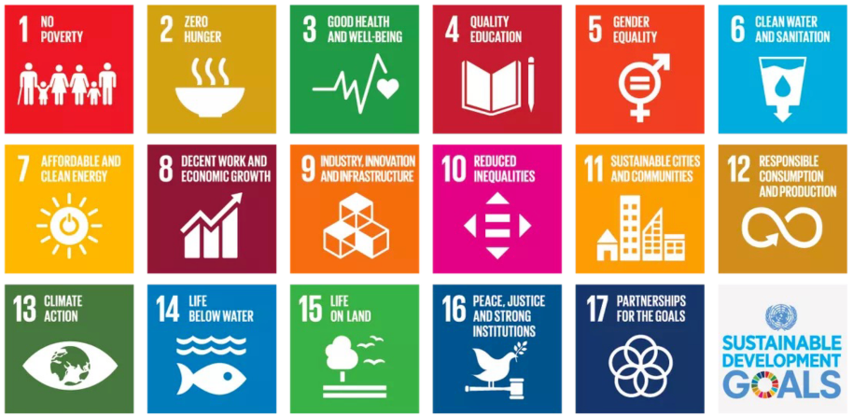
16 SDGs categories for research
Notes:
In case you have never heard of the SDGs, here is a colourful list.

Slide 5


Why SDGs?
University output as categorized by SDG used in
McMaster University (2022):
9th in Canada
37th in World
…but 80th in
Some institutions do better in Impact than World rankings.
Notes:
The Times Higher Education (THE) consultancy has highlighted the role of SDGs in academia by providing ‘Impact Rankings’, which, starting in 2019, rank institutions by their research output as defined by the SDGs (Times Higher Education, 2022). This provides some context in which universities can benchmark their efforts against other institutions. Across all Impact Rankings criteria, McMaster rated 93.1, and is ranked ninth in Canada and 37th in the world in 2022. Part of THE’s methodology includes evaluating universities’ research output that is linked to SDGs. While useful to assess and promote an institution’s SDG-related research publications overall, the Impact Rankings cannot provide details at the faculty or departmental level.

Slide 6
Why interdisciplinarity?
New Frontiers in Research Fund
$142 million for “Canadian-led, interdisciplinary research projects” (March 13, 2025)
Tri-Agency Interdisciplinary Peer Review Committee
SSHRC Insight Grants
CIHR Project Grant
NSERC Discovery Horizons
“Applications… must represent research across disciplines and subject areas… that clearly articulate interdisciplinary approaches.”
“Interdisciplinarity must be a key characteristic of proposed projects, where the project goals could not be achieved without an interdisciplinary approach.”

Slide 7
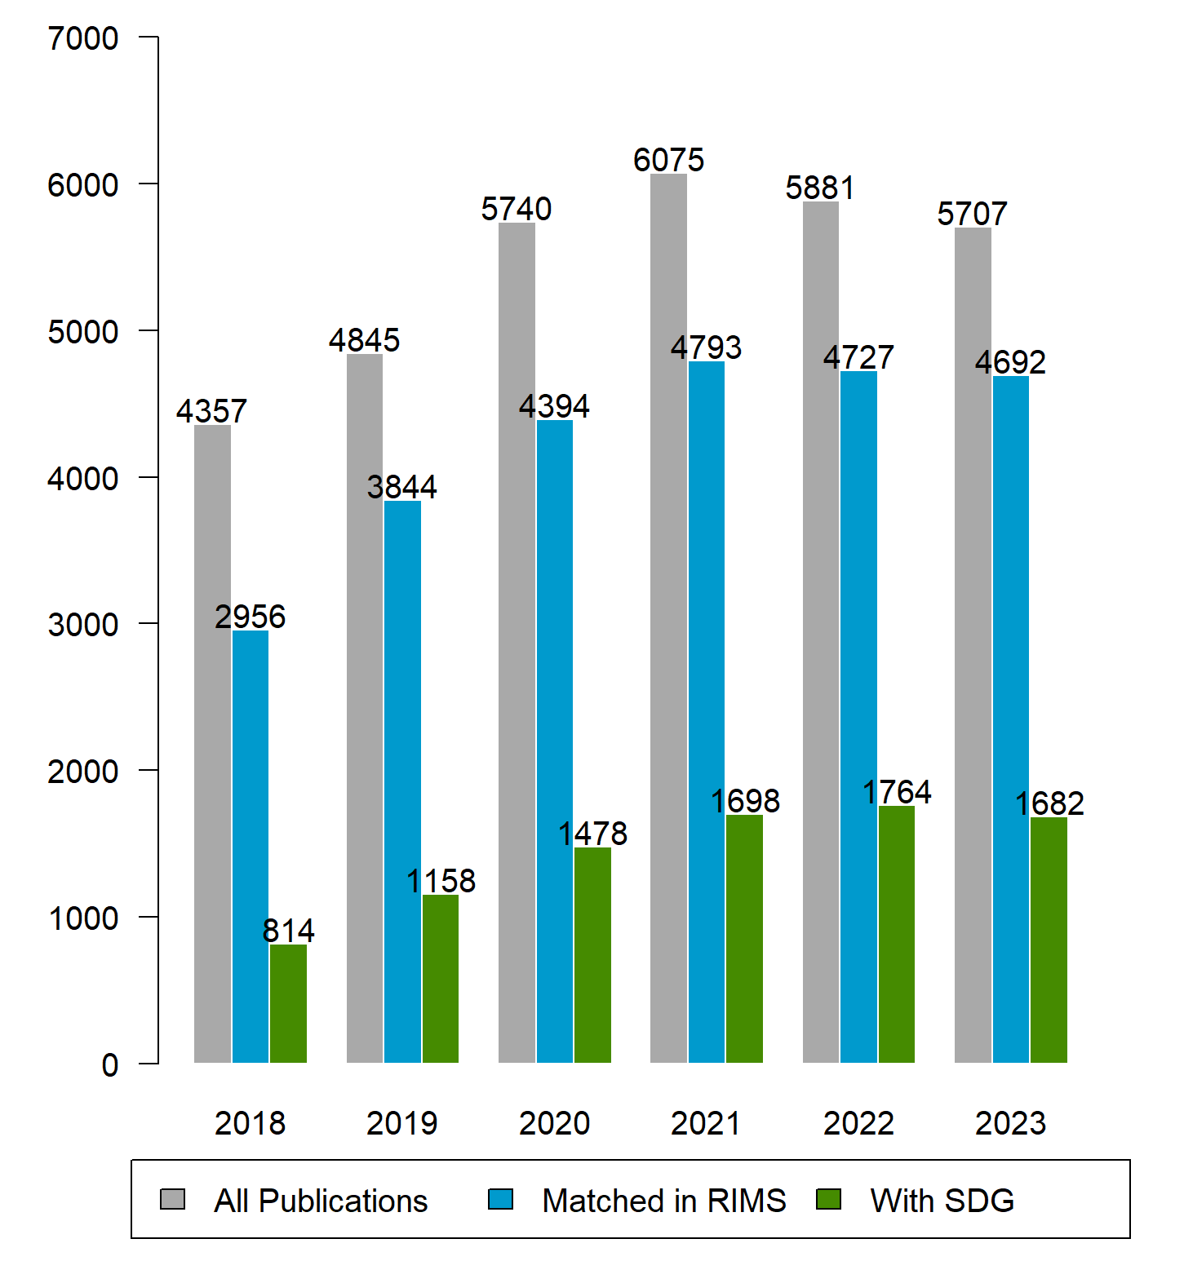
Methods
Dimensions: 32,605 publications
1+ author @ McMaster
6 years: January 2018 → December 2023
Research Article, Review Article, Conference Paper
Matched 25,406 publications by DOI in RIMS
8,594 had SDG category by Dimensions
Data & Methods available on Figshare:
Demaine, Jeffrey; Bhatia, Yash; Whalen, Kate (2024). Supplementary materials: "Mapping publications by Sustainable Development Goal at the faculty level to highlight inter-faculty collaborations". figshare. Dataset. https://doi.org/10.6084/m9.figshare.25075727.v1

Slide 8
1- SDG publications by Faculty
8,594 publications map to 9,345 categorizations-by-affiliations
Because…
Distribution is highly skewed:
Health Sciences: 70.5% of McMaster’s total.
Of these, 88.7% address SDG #3 - Good Health and Well Being.
Engineering: 1,179 publications (12.6% of total)
of which 725 (61.5%) in SDG #7- Affordable and Clean Energy.
Science: 10.6% of output
47% are also SDG #3 - Good Health and Well Being
Notes:
Because a publication may be about multiple SDGs as well as being authored by researchers from different faculties, the 8,594 publications map to 9,345 categorizations-by-affiliations, allowing comparisons of faculties by their output in each SDG. For brevity this data is not shown, but the main points are highlighted:
The distribution of publications by faculty is highly skewed, with the Faculty of Health Sciences producing 6,588 publications (70.5% of McMaster’s total output).
Of these, 88.7% address SDG #3 - Good Health and Well Being.
A distant second place is the Faculty of Engineering with 1,179 publications (12.6% of total output), most of which (725; 61.5%) fall into Goal #7- Affordable and Clean Energy.
Science only produces 10% of McMaster’s output. Almost half of these are also in SDG 3. So there is a considerable overlap with the Faculty of Health Sciences.

Slide 9
1 - SDG publications by Faculty
SDG | Health Sciences | Engineering | Science | Social Sciences | Business | Humanities
1 No Poverty | 5 | 1 | 2 | 5 | 1 | 1
2 Zero Hunger | 54 | 11 | 31 | 8 | 4 | 1
3 Good Health and Well Being | 5,845 | 175 | 427 | 222 | 68 | 17
4 Quality Education | 446 | 18 | 27 | 39 | 15 | 25
5 Gender Equality | 54 | 2 | 6 | 34 | 10 | 3
6 Clean Water and Sanitation | 9 | 28 | 29 | 3 | 1
7 Affordable and Clean Energy | 9 | 725 | 89 |  | 3
8 Decent Work and Economic Growth | 10 | 1 | 9 | 35 | 11 | 1
9 Industry, Innovation and Infrastructure | 1 | 31 | 1 |  | 19
10 Reduced Inequalities | 10 | 1 | 9 | 19 | 4 | 1
11 Sustainable Cities and Communities | 22 | 25 | 16 | 5 | 7
12 Responsible Consumption & Production | 2 | 19 | 2 |  | 8
13 Climate Action | 8 | 111 | 115 | 8 | 5
14 Life Below Water | 5 | 4 | 42 | 2 | 2
15 Life on Land | 2 | 22 | 97 | 4 |  | 2
16 Peace, Justice and Strong Institutions | 97 | 4 | 12 | 31 | 14 | 22
Notes:
SDG 3: Good Health and Well Being: Of the 6,420 publications related to SDG 3, 6,064 (94.5%) were produced by a single faculty. Only 356 (5.5%) involved researchers from two or three faculties. The greatest number of these collaborations brought together researchers from the faculties of Science and of Health Sciences.
SDG 4: Quality Education: Among all 540 publications related to SDG 4, a total of 503 (93.1%) were written by researchers from within the same faculty, and 37 publications (6.8%) involved researchers from two or three faculties. These were sprinkled across a range of collaborators, mostly involving the Faculty of Health Sciences.
SDG 7: Affordable and Clean Energy: Among all 815 publications related to SDG 7, a total of 787 (96.5%) were the result of single-faculty research, with only 28 (3.4%) bringing together researchers from two or three faculties. Interestingly, all but two involved the faculties of Engineering and Science.

Slide 10
1 - SDG publications: interdisciplinarity
Notes:
To tease out the patterns of collaboration within the 9,345 categorizations and affiliations, the publications were split into those involving only one faculty, and those resulting from inter-faculty collaborations. Again, because some publications correspond to more than one SDG, the 8,594 publications linked with a faculty member in McMaster Experts were assigned to 8,919 SDG categories by Dimensions (that is; 325 publications were assigned to two or more SDG categories). Of these, 8,432 (94.5%) were produced by a single faculty. Only 487 (5.5%) were the result of a collaboration between two or three faculties (see Table 1). The three areas of research with the most inter-faculty collaborations are:
SDG 3: Good Health and Well Being: Of the 6,420 publications related to SDG 3, 6,064 (94.5%) were produced by a single faculty. Only 356 (5.5%) involved researchers from two or three faculties. The greatest number of these collaborations brought together researchers from the faculties of Science and of Health Sciences.
SDG 4: Quality Education: Among all 540 publications related to SDG 4, a total of 503 (93.1%) were written by researchers from within the same faculty, and 37 publications (6.8%) involved researchers from two or three faculties. These were sprinkled across a range of collaborators, mostly involving the Faculty of Health Sciences.
SDG 7: Affordable and Clean Energy: Among all 815 publications related to SDG 7, a total of 787 (96.5%) were the result of single-faculty research, with only 28 (3.4%) bringing together researchers from two or three faculties. Interestingly, all but two involved the faculties of Engineering and Science.

Slide 11
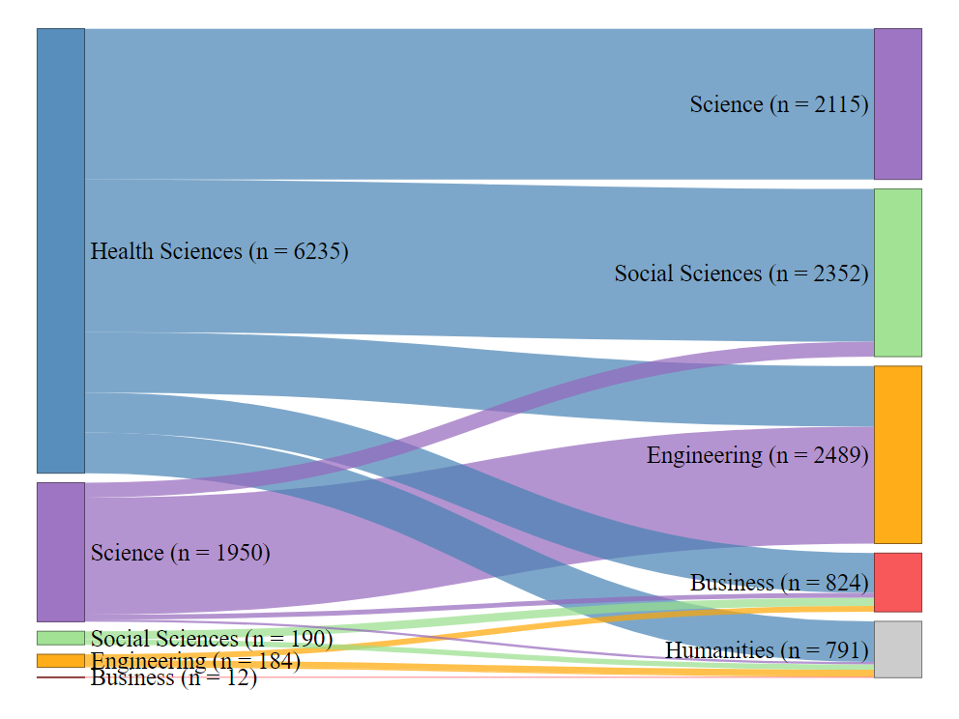
2 – Matching research across Faculties
Not counting SDG 3
Have NOT already co-authored
Matching on SDG + ANZSRC
8,571 cross-Faculty pairings
Notes:
Because such a large proportion of McMaster’s publications are categorized as SDG 3, for practical purposes the matching was limited to the 16 other SDGs. The result is 8,571 pairs of authors, along with their respective departmental and faculty affiliations, who have not already collaborated, but who have the potential to do so (see Figure 1).
Note that even when we exclude SDG 3 (“Good Health and Wellbeing”), the Faculty of Health Sciences is still the source for the vast majority of potential research collaborations.

Slide 12
2 – Matching research across Faculties
SELECT DISTINCT ME1.User_FULLname, ME1.Faculty, ME1.Department, ME2.User_FULLname, ME2.Faculty, ME1.Department, ME1.SDG, ME1.ANZSRCfield
FROM MatchedExpanded AS ME1, MatchedExpanded AS ME2
WHERE ME1.Article_ID != ME2.Article_ID
AND ME1.Faculty != ME2.Faculty
AND ME1.User_FULLname != ME2.User_FULLname
AND ME1.SDG == ME2.SDG
AND ME1.ANZSRCfield == ME2.ANZSRCfield
AND ME1.ANZSRCcode > 1000
AND ME1.SDG != "3 Good Health and Well Being"
AND NOT EXISTS (SELECT *
FROM CoAuthoredPreviously
WHERE (ME1.User_FULLname == CoAuthoredPreviously.CoAuthor1
AND ME2.User_FULLname == CoAuthoredPreviously.CoAuthor2)
OR (ME1.User_FULLname == CoAuthoredPreviously.CoAuthor2
AND ME2.User_FULLname == CoAuthoredPreviously.CoAuthor1))
ORDER BY ME1.User_FULLname
LIMIT 60000;
Notes:
Identifying potential collaborators across faculties involves some fairly tricky SQL.
There is a fair bit of data manipulation required before this final big query.
Not easy to understand.

Slide 13
2 - Identification of potential collaborations
Potential collaboration?
Professor A
(Faculty A)
Professor C
(Faculty C)
SDG B
+
ANZSRC topic B
Note A → B → C linkage
Notes:
A simplified way of thinking about the matching.
Remember this diagram: we will see it again in Part 2 of this talk.

Slide 14
3 – Expert input – test case
New Frontiers in Research fund announces grant on “sustainable transportation”
Our dataset contains 8,571 pairs of authors (without SDG 3).
The computational part is done, now human judgement is required.
Filter by:
SDG 7 “(“Affordable and Clean Energy”)
SDG 11 (“Sustainable Cities and Communities”)
Add more granularity: ANZSRC fields of research:
3304 Urban and Regional Planning
3509 Transportation, Logistics and Supply Chains
4011 Environmental Engineering
Select two Faculites:
Engineering
Science
18458
All rows
2832
SDG 7; 11
358
ANZSRC
168
2 Faculites
28
Distinct
Notes:
Simply using computation is not a practical approach.
A combination of filtering and expert judgement produces a small set that can be useful for university leadership.
The goal is not to remove human expertise, but to reduce the range of possibilities in a way that is logical. This approach to bibliometrics does not result in a spreadsheet. Instead, it produces options and gives management actionable information.

Slide 15
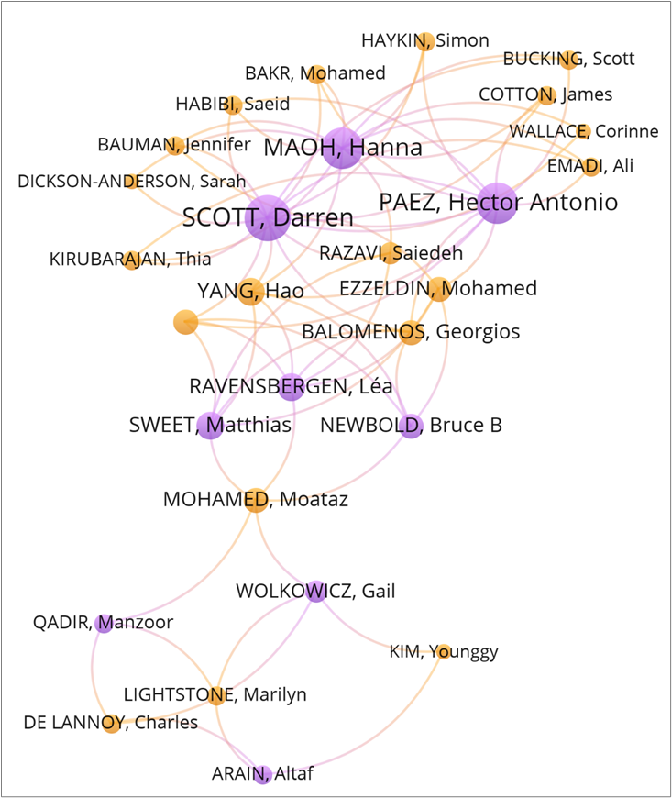
3 – Expert input
19 from the Faculty of Engineering
9 from the Faculty of Science
Bibliographic coupling of their previous articles arranges people by their citing similarity.
Hanna Maoh’s previous publications are on transportation:
“Battery electric vehicle acquisition timeframes in Canadian fleets” (Transportation Planning and Technology)
“Examining the Variability of Crossing Times for Canadian Trucks at the Three Major Canada–U.S. Border Crossings” (Professional Geographer)
Saiedeh Razavi is near Maoh. His research seems similar:
“Adoption patterns of autonomous technologies in Logistics: evidence for Niagara Region.” (Transportation Letters)
“Transportation data visualization with a focus on freight: a literature review” (Transportation Planning and Technology)
Notes:
Thus, by combining techniques to manipulate the metadata with the interpretation of textual meaning, a process is arrived at that successfully identified two researchers who, despite not having co-authored together seem to be publishing on a similar topic. This alignment suggests that they would be ideal collaborators on which a grant proposal could be based.
This example illustrates how the leadership of the university can, by selecting a few criteria and then performing a quick scan of the paired authors’ publications, arrive at new insights into the untapped potential collaborations that exist across campus. Once the metadata has been compiled, no particular technical skills are required to identify matching authors based on common research interests. It is straightforward to create a dashboard that would provide a user-friendly interface, allowing managers to filter the data with a few clicks.

Slide 16
PART 2 - Parallels with Linked Literature Analysis
No longer talking about SDGs and Faculties!
Notes:
Identification of potential collaborations
The ANZSRC is a hierarchy of 1,754 specific research Fields organized into 190 broader Groups that are in turn collected into 23 general research Divisions. Dimensions assigns two levels of ANZSRC codes to publications: two-digit Divisions (e.g. “34 Chemical Sciences”), four-digit Groups (e.g. “3402 Inorganic Chemistry”). Potential co-authors are identified by selecting publications with matching SDG and ANZSRC Field of Research classifications, but where the authors’ faculty affiliations are different.
Expert input in selecting collaborators
The manipulation of structured information should be used to inform, but not replace, expert input. The final step of this process is to provide the managers and administrators who understand the needs of the institution with a range of choices in an accessible format. By combining the ability to process large quantities of data with the contextual knowledge of humans can insights be drawn.

Slide 17
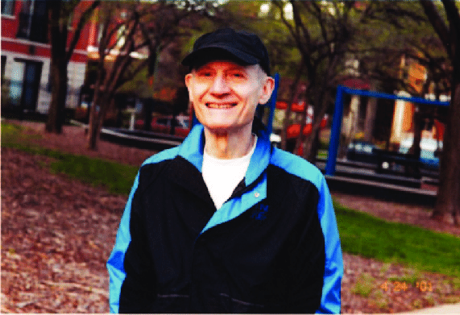
Parallels with Linked-Literature Analysis
Don Swanson
“Undiscovered Public Knowledge” in PubMed
Fish Oil and Raynaud’s Disease (1986)
Migraine and magnesium
Somatomedin C and arginine
Potential discovery?
Fish Oil
MeSH term A
Raynaud’s Disease
MeSH term C
Blood Circulation
MeSH term
B
Note A → B → C linkage
Notes:
In 1986, Don Swanson postulated that Fish Oil could be used to treat Raynaud's Disease because they both co-occurred in PubMed with the concept of Blood Circulation (Swanson, 1986). At that time, PubMed contained no records that listed both Fish Oil and Raynaud's Disease as MeSH terms simultaneously. Could there be a causal relationship between these concepts because they are linked via a common third term? Lab research subsequently confirmed Swanson’s hypothesis that Raynaud's Disease could indeed be treated with Fish Oil. Several other hypotheses were generated in this way, with subsequent studies confirming a causal biomedical effect (Swanson, 1988; Swanson, 1990). The success of Swanson's "Linked Literature Analysis" technique suggested that latent discoveries exist in the scientific literature and launched the field of "Undiscovered Public Knowledge" (UPK). A subsequent experiment by Demaine, Martin, and De Bruijn (2003) found that by limiting PubMed searches in the form "(A ∩ C) ∪ (C ∩ B)" to articles published before a given year could identify 8% more "A ∪ B" in subsequent years. These are the hypothesized links between concepts that turn out to be true. This suggests that discovering likely hypotheses can be automated by using the LLA technique in brute-force searches of the scientific literature.
While Swanson’s LLA technique was intended to facilitate biomedical discoveries, the method described in this article is intended to facilitate the management of academic research. As a variation of the original LLA technique, potential collaborators from different faculties whose research occurs is the same SDG are identified. The applicability of this technique in a bibliometric context suggests that the methods of UPK are generalizable to areas beyond bioinformatics.

Slide 18
Similar patterns can be applied to Schol Comm
Finding potential collaborators across Faculties is an instance of Swanson’s LLA technique.
So LLA is not restricted to PubMed or biomedicine.
We can apply hypothesis-generation in Bibliometrics.
Further possibilities:
One-node A-B-C (Swanson’s original Linked-Literature Analysis)
Two-node A-B-C (Smalheiser’s ARROWSMITH tool)
Multi-step paths (Baek et al., 2017; Hossain et al., 2012; Sebastian, Siew, & Orimaye, 2017)
Ranking of shared/implicit relationships (Wren et al. 2004)
Notes:
While the research in this field involves complex text analysis and statistical methods that are too abstract for the day-to-day needs of librarians and bibliometricians, it remains that the underlying models could be applied in the context of bibliometrics. While most of the approaches are designed to deal specifically with biomedical literature, the example of using Swanson's A-B-C technique to look for potential interdisciplinary collaborators shows that these knowledge-discovery methods can be repurposed to inform bibliometric analyses.
LLA is just one of the ways in which metadata can be repurposed to uncover latent connections in the research literature. The broader field of UPK offers other models for inferring relationships from metadata. If the identification of potential collaborators across faculties is an example of how one technique from the field of UPK can be re-purposed to help universities manage research, it seems likely that other models for extracting meaning from metadata could be applied in a similar way. Smalheiser (2017) points out several other techniques for inferring new knowledge from publicly-accessible bibliographic metadata:
One-node A-B-C (Swanson’s original Linked-Literature Analysis)
Two-node A-B-C (Smalheiser’s ARROWSMITH tool: https://arrowsmith.psyvh.uic.edu)
Multi-step paths (Baek et al., 2017; Hossain et al., 2012; Sebastian, Siew, & Orimaye, 2017)
Ranking of shared/implicit relationships (Wren et al. 2004)
Borrowing these approaches from the field of UPK brings a whole new type of methodology to the analysis of scholarly communication. Instead of using publication metadata to measure institutional performance in a retrospective sense, patterns within the same metadata can be leveraged to produce more forward-looking insights. Promising collaborations and new directions for research can be extracted from the academic literature, enabling the management of a university to plan ahead based on uncovering connections that were previously hidden.

Slide 19
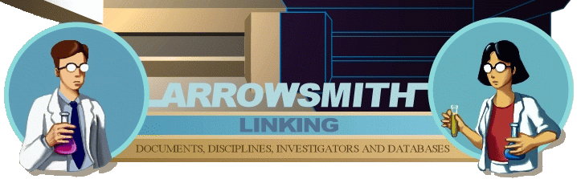
Can LLA be automated?
Demaine, J., Martin, J., & De Bruijn, B. (2003). Haystacks and hypotheses. Proceedings of the American Society for Information Science and Technology, 40(1), 59–64. https://doi.org/10.1002/meet.1450400107
Pretend it is 1995. Search PubMed for all MeSH terms that do not co-occur (“A” and “C”), but which share a third co-occurring term (“B”). How many A+C co-occurrences happen after 1995?
Result = 8%
BITOLA - Biomedical Discovery Support System
University of Ljubljana, Slovenia - circa 2005
https://ibmi3.mf.uni-lj.si/bitola/
ARROWSMITH
University of Illinois
https://arrowsmith.psych.uic.edu/arrowsmith_uic/
Notes:
LLA is just one of the ways in which metadata can be repurposed to uncover latent connections in the research literature. The broader field of UPK offers other models for inferring relationships from metadata. If the identification of potential collaborators across faculties is an example of how one technique from the field of UPK can be re-purposed to help universities manage research, it seems likely that other models for extracting meaning from metadata could be applied in a similar way. Smalheiser (2017) points out several other techniques for inferring new knowledge from publicly-accessible bibliographic metadata:
One-node A-B-C (Swanson’s original Linked-Literature Analysis)
Two-node A-B-C (Smalheiser’s ARROWSMITH tool: https://arrowsmith.psyvh.uic.edu)
Multi-step paths (Baek et al., 2017; Hossain et al., 2012; Sebastian, Siew, & Orimaye, 2017)
Ranking of shared/implicit relationships (Wren et al. 2004)
Borrowing these approaches from the field of UPK brings a whole new type of methodology to the analysis of scholarly communication. Instead of using publication metadata to measure institutional performance in a retrospective sense, patterns within the same metadata can be leveraged to produce more forward-looking insights. Promising collaborations and new directions for research can be extracted from the academic literature, enabling the management of a university to plan ahead based on uncovering connections that were previously hidden.

Slide 20
LLA + LLMs
Don Swanson (ARROWSMITH, BITOLA) relied on the MeSH controlled vocabulary.
→ LLA limited to BioMedical field
Now, LLMs can infer semantic relationships from raw text.
→ Hypothesis generation by non-specialists now possible in any field
DiscipLink: LLM tool that helps researchers identify potentially relevant topics in other (interdisciplinary) fields:
Zheng, C., Zhang, Y., Huang, Z., Shi, C., Xu, M., & Ma, X. (2024). DiscipLink: Unfolding interdisciplinary information seeking process via human-AI co-exploration. In Proceedings of the 37th Annual ACM Symposium on User Interface Software and Technology, 1–20. UIST ’24. New York, NY, USA: Association for Computing Machinery. https://doi.org/10.1145/3654777.3676366.
Resurgence of research in UPK driven by AI:
Alkan, A. K., Sourav, S., Jablonska, M., Astarita, S., Chakrabarty, R., Garuda, N., Khetarpal, P., et al. (2025). A survey on hypothesis generation for scientific discovery in the era of Large Language Models. arXiv. https://doi.org/10.48550/arXiv.2504.05496.
Notes:
Until recently, interest in LLA and UPK was waning as the researchers who were active in this field in the 1990s and early 2000s wound down their careers. Even in its heyday, Swanson’s technique remained a curiosity within information science and never really caught on with the medical research community (Spasser, 1997). However, in the past few years the advent of interactive artificial intelligence tools based on large language models (LLMs) has opened the door to the popularization of advanced hypothesis-generation techniques. Crucially, the LLMs function by inferring semantic relationships from raw text. Where once LLA was restricted to the biomedical field because of its reliance on the cataloguing of articles by MeSH terms, LLMs calculate the meaning between concepts in any context, and from these causal linkages can be generated. This will allow UPK techniques to be used with any set of documents.
Just as revolutionary as the technical underpinnings of AI language models, their ease of use allows their use by non-specialists. Whereas earlier research in UPK was confined to those with advanced coding skills as well as an interest in information science, users can now interact with powerful new AI tools simply by issuing a series of questions and prompts. If linked-literature techniques such as those invented by Swanson and Smalheiser can be formulated as commands and questions, users might be able to generate new insights in any field and make discoveries without the need for complex programming. Indeed, recent publications in information science suggest that AI has arrived just in time to prevent the concept of UPK from fading into history. A team from China recently developed DiscipLink, an LLM-powered tool that helps researchers identify potentially relevant topics in other (interdisciplinary) fields (Zheng et al. 2024). And a large international team has just released a survey of the use of LLMs for hypothesis generation (Alkan et al. 2025).

Slide 21
Summary
Part 1: Mapping SDGs by Faculty
Basic SDG-by-Faculty analysis
Re-combine metadata to calculate all SDG + ANZSRC matches across faculties
Target a specific grant: filter dataset to find handful of potential collaborators
Part 2: Similarity with Linked Literature Analysis
…implies applicability of hypothesis-generation techniques in Bibliometrics
Integration of LLA/UPK with AI enables hypothesis generation in any field.
3 techniques you can use to analyze/identify collaborations.
Predictive analytics as new conceptual approach to Bibliometrics.
Mapping publications by SDG at the faculty level… (2024): https://doi.org/10.1108/IJSHE-01-2024-0058
Methods & data (Figshare): https://doi.org/10.6084/m9.figshare.25075727.v1
Haystacks and Hypotheses (2003): https://doi.org/10.1002/meet.1450400107

